Slide 1
Armstrong County
Election Worker
Training
September2024

Slide 2
Important Numbers
Election office phone 806-410-1297
Tamara’s Election Cell Phone 806-673-5936

Slide 3
Early Voting
Dates and Times
October 21st-25th
8AM-5PM
October 26th 7AM-7PM
October 27th 9AM-3PM
October 28-November 1
7AM-7PM

Slide 4
Early Voting Location
ARMSTRONG COUNTY COURTHOUSE
BASEMENT (Westside entrance)
101 TRICE STREET
Election Day Locations
101,201,202,301,401,& 404- Court Room2nd floor, Armstrong County Courthouse 101 Trice Street Claude
303- Wayside Fires station 3407 CO. Rd. 5 Wayside
402- Armstrong County Emergency Building 301 Duncan Washburn

Slide 5
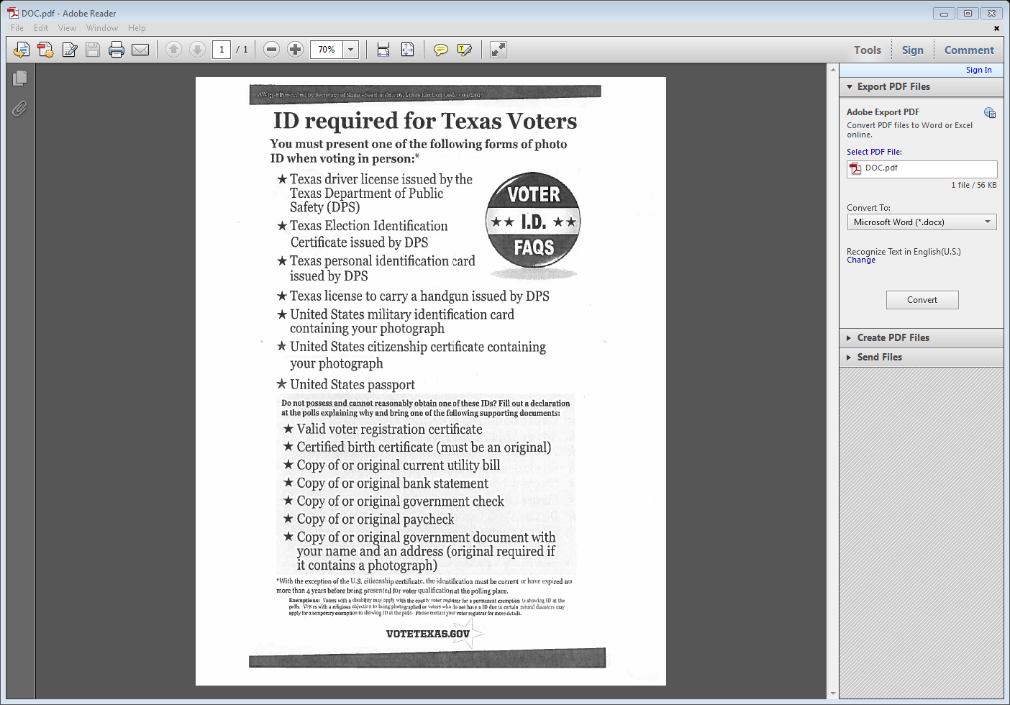
This MUST be posted on the exterior door of your building.

Slide 6
Four Categories
1. Department of Public Safety
  Texas Driver License
  Texas ID
  Texas Concealed Handgun Permit
  Election Identification Certificate
2. Military ID Cards
  Department of Defense (DoD) Common Access Card (CAC)
  Uniformed Services ID Cards
  DoD Civilian Retiree Cards
  Veterans Affairs ID Cards
3. Citizenship
  Citizenship Certificate
  Naturalization Certificate
4. Passport
  Passport Book
  Passport ID Card

Slide 7
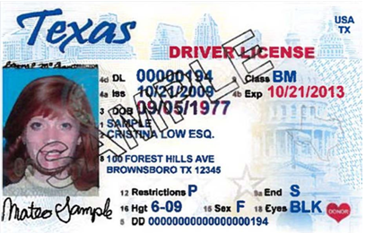
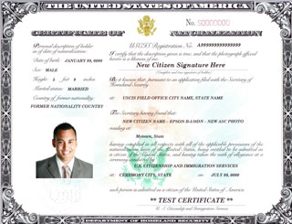
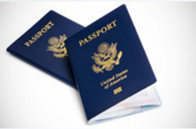
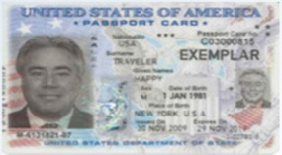
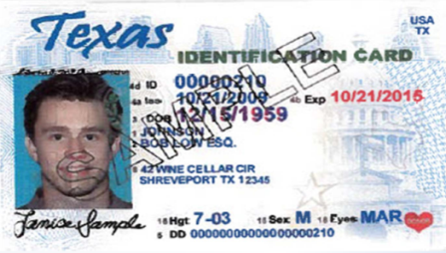
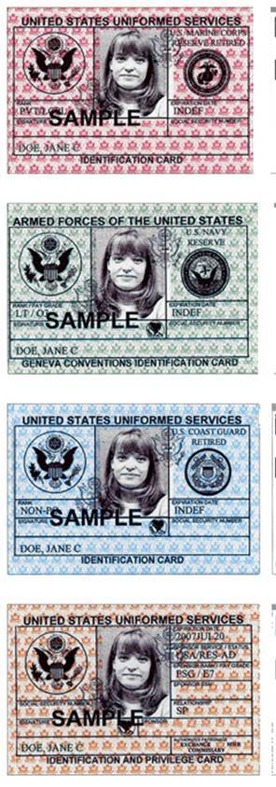
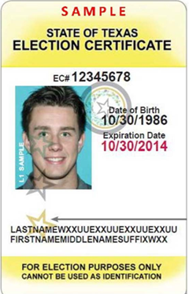
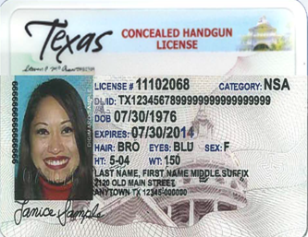
4 Categories of Acceptable forms of ID
TX Driver license issued by DPS
US Citizenship certificate showing photo.
US Passport book or Passport ID Card
TX Personal ID Card issued by DPS
TX Election ID Certificate (EIC) issued by DPS
TX concealed handgun license issued by DPS
US Military ID card/CAC card

Slide 8
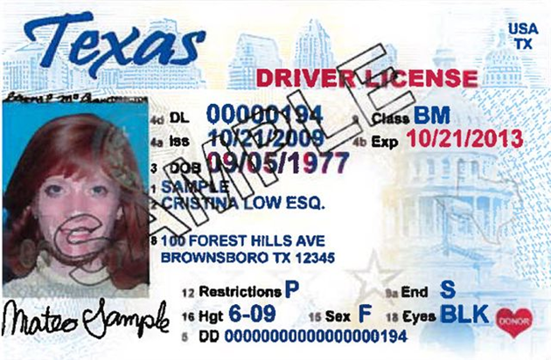
Driver’s License
Photograph: Texas law requires the ID to have a photograph of the voter.
Expiration Date: Per §63.0101 must be valid, or expired within 4 years.
Name: If the voter’s name on list of registered voters in the precinct, does not match exactly to the ID provided, a “Substantially Similar Name Affidavit” must be completed by the voter.

Slide 9
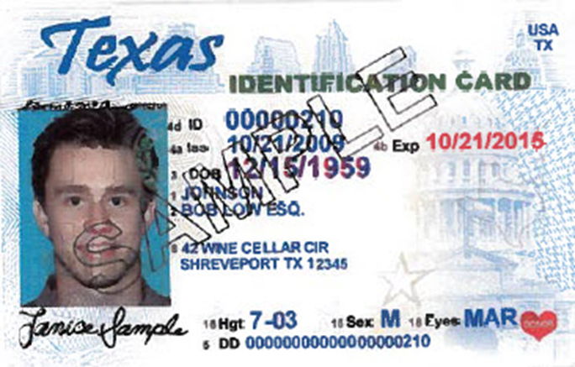
Texas Personal Identification Card
Photograph: Texas law requires the ID to have a photograph of the voter.
Expiration Date: Per §63.0101 must be valid, or expired within 4 years.
Name: If the voter’s name on list of registered voters in the precinct, does not match exactly to the ID provided, a “Substantially Similar Name Affidavit” must be completed by the voter.

Slide 10
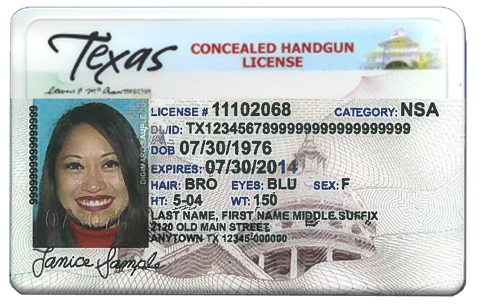
Concealed Handgun License
Photograph: Texas law requires the ID to have a photograph of the voter.
Expiration Date: Per §63.0101 must be valid, or expired within 4 years.
Name: If the voter’s name on list of registered voters in the precinct, does not match exactly to the ID provided, a “Substantially Similar Name Affidavit” must be completed by the voter.

Slide 11
7 Acceptable forms of
Photo ID
With the exception of the U.S. Citizenship Certificate and the Veteran Affairs ID, the identification must be current or have expired no more than 4 years before being presented for voter qualification at the polling place.

Slide 12
Unacceptable forms of ID
School/University IDs
Employment IDs
Out of State Drivers License OR Out of State ID’s.

Slide 13
Reasonable Impediment Declaration
If a voter has not been able to obtain one of the acceptable photo identification listed previously, and the voter has a reasonable impediment to obtaining such identification, the voter has the right to execute a Reasonable Impediment Declaration and present one of the following supporting documents:
valid voter registration certificate
Certified birth certificate (must be an original)
Copy of or original current utility bill
Copy of or original bank statements
Copy of or original government check
Copy of or original paycheck
Copy of or original other government document that displays the voter’s name & address

Slide 14
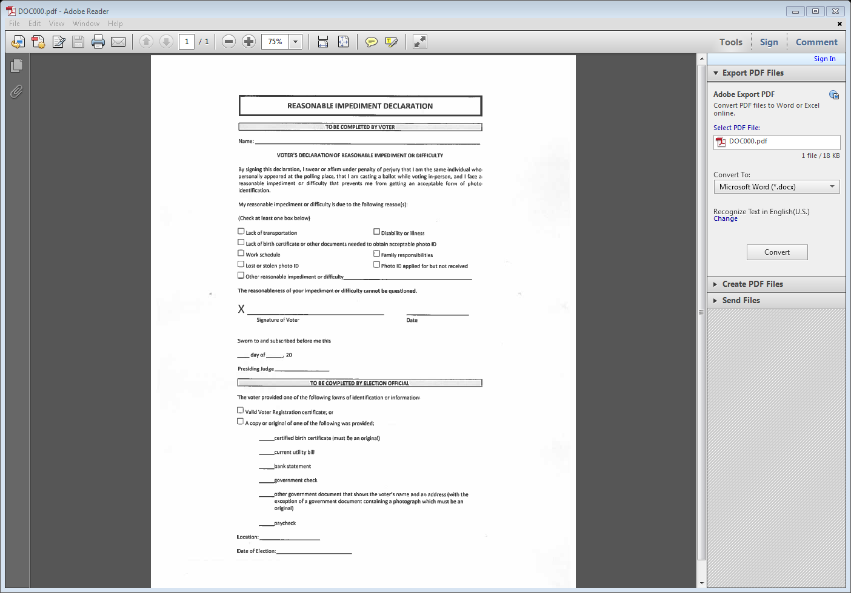
Reasonable Impediment Declaration

Slide 15
What if a Voter does not have any of these forms of photo ID
If a voter does not have his or her voter registration certificate AND the voter does not have any of the photo IDs indicated above at the of voting, the voter may cast a provisional ballot at the polls.
However, in order to have the provisional ballot counted, the voter will be required to visit our voter registrar’s office within six calendar days of the date of the election to either present one of the above forms of photo ID OR submit one of the temporary affidavits addressed below (e.g., religious objection or natural disaster) in the presence of the county voter registrar while attesting to the fact that he or she does not have any of the required photo IDs.

Slide 16
What if a Voter does not have any of these forms of photo ID cont..
Please make sure you hand them a Notice to Provisional Voter Form to include the Ballot Access Code along with the expiration date in the block area of the form and the Map with Directions (that includes the hours of operation) to our Voter Registrar’s office.

Slide 17
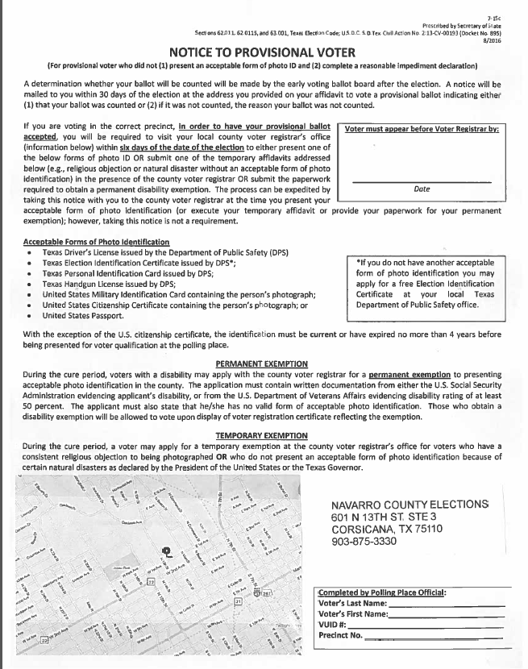
Notice to Provisional voter:
Voter will have 6 calendar days after the election day to visit our office to present one of the 7 ID to submit in order to have their provisional ballot counted.

Slide 18
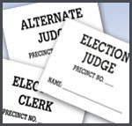
Personnel Guidelines continued…
Name Tags
  Must be worn at all times.
  Include Name and Title.
Absences/Tardiness
  Please call your judge if you are running late and not going to make it.
  Tardiness creates an interruption in workflow and should be prevented if possible.
Politicking
  No politicking is allowed in the polling place.
  Leave all buttons, pins, or other political items at home.
  Shirts/hats supporting candidates may not be worn.
  Cars should not display bumper stickers, signs, or any other politically motivated material.
Use of Personal Cell Phone
  Should only be used when away from the voting area or during emergency situations.

Slide 19

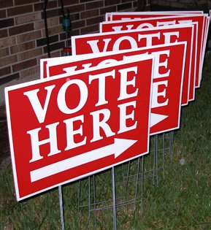
Opening the Polls
Lets Open The Polls. Do you have:
  These Forms:
    Oath of Office and Assistance
    Timesheets
    Ballot and Provisional Bags
  Did you post your signs?
  Inside and Outside

Slide 20
Assisting the Voter
Who is Eligible?
  Any voter who is physically unable to mark the ballot.
  Any voter who cannot read the ballot.
What is Allowed?
  Reading the ballot to the voter
  Directing the voter to read the ballot.
  Marking the voter’s ballot.
  Directing the voter to mark the ballot.

Slide 21

Assisting the Voter
Who Can Assist?
  Any person the voter chooses.
    EXCEPT: the voter’s employer, an agent of their employer, or agent of the voters union.
  Candidates may assist a voter.
Persons can provide assistance regardless of:
  The fact they have assisted someone else.
  Their residence.
  Their citizenship.
  Their voter registration status.
  Their Age

Slide 22
Assisting the Voter
What if the voter doesn’t choose their assistant?
  Election Officers may assist a voter.
  One election officer instead of two may assist
  per code §§ 85.034, 85.035.
Who else can be there?
  If the voter chooses an assistant, no one else may be present.
  If election workers are assisting a voter, poll watchers may be present to observe.
An Interpreter may assist the voter.
  Interpreters must be registered in the political subdivision.
  Remember: unless the voter is eligible for assistance, the interpreters job ends when the voter gets his/her ballot.

Slide 23

Assisting the Voter
What else does an interpreter or assistant need to do?
  Take the Oath of Assistance
  Election official must ask the voter if they want the entire ballot read to them, and if so, must instruct the assistant to do so.
  Must NOT mark the ballot in anyway other than how the voter indicates they want the ballot marked. Offense is a Class A Misdemeanor.

Slide 24


Curbside Voting
What is curbside voting?
  Curbside voting is the assistance of a voter at their vehicle. This is not DRIVE-UP voting. The voter must be physically unable to enter the polling place.
What is the process?
  Qualify the voter as you would any other voter with one of the seven (7) categories of acceptable forms of ID.
  Once qualified an election official may deliver a ballot to the voter “curbside”.
  Poll Watchers and inspectors may observe curbside voting.

Slide 25
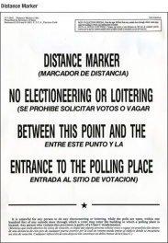
Electioneering
Electioneering
  It is unlawful for any person to electioneer or loiter within the boundary established by the distance markers. This offense is classified as a Class C misdemeanor. (Sec.61.003)
  **Distance Markers for Early Voting are to be set at 100 feet**
Unlawful Operation of Sound Amplification Device or Sound Truck:
  A person commits an offense if, during the voting period and within 1,000 feet of a building in which a polling place is located, the person operates a sound amplification device or a vehicle with a loud speaker while the device or loudspeaker is being used for the purpose of:
    Making a political speech; or
    Electioneering for or against any candidate, measure or political party

Slide 26
THE CUSTOMER SERVICE ATTITUDE
Please remember that while working as an election official in the polling place you are our “Official Customer Service Representative”. Servicing the voters of Dallas County and running a smooth election are your top priorities.
TIPS FOR A SUPER CUSTOMER SERVICE ATTITUDE
Remember to be courteous and respectful to everyone at all times.
SMILE
Always ENCOURAGE rather than DISCOURAGE
Should you experience a difficult situation at your polling place do not allow it to negatively affect those around you. Do your best to correct it. However…
If the situation is more than you can handle do not hesitate to call our office immediately.
Remember the Election Judge is responsible for the location; he/she will assign the duties and responsibilities accordingly to how he/she believes is best for the location.
Win the Customer not the Argument.

Slide 27

Conflict/Crisis Management
How to handle conflict with:
    Unruly Voters
    Election Worker Staff
    Early Voting Location Site Staff
How to manage/handle a crisis with:
    A Large Crowd
    Election Equipment Malfunction
    People seeking petition signatures
    outside of the Distance Marker

Slide 28
Poll Watchers
You may have a Poll Watcher visit your location. Here is what you need to know:
1. A Poll watcher must be appointed. In other words they can’t just show up because
they want to come.
2. They must present a Certificate of appointment to you.
-The Certificate should list the Number and place of Service.
    -The person must be eligible for this appointment.
3. He or she MUST wear a Name Tag at all times (SB 160).
4. Each time the Watcher reports for service he/she must notify the Election Judge.
5. A watcher may be present at the polling place at any time it is open until the
completion of the day’s voting. A Watcher may serve the hours he/she chooses.
6. A poll watcher is just that – a watcher. They are there to observe activity in your
location. They may make notes, and are eligible to inspect records prepared by
election officials.
7. Watchers are not allowed to:
    - Bring in any type of recording devices.
    -Converse with the election officers regarding the election, except to call attention to an
    irregularity or violation of the law.
    -Converse with the voter.
    -Communicate in any manner with the voter regarding the election.
    -Possess a device capable of recording images or sound unless agrees to disable or
    deactivate.
See pages 71-73

Slide 29
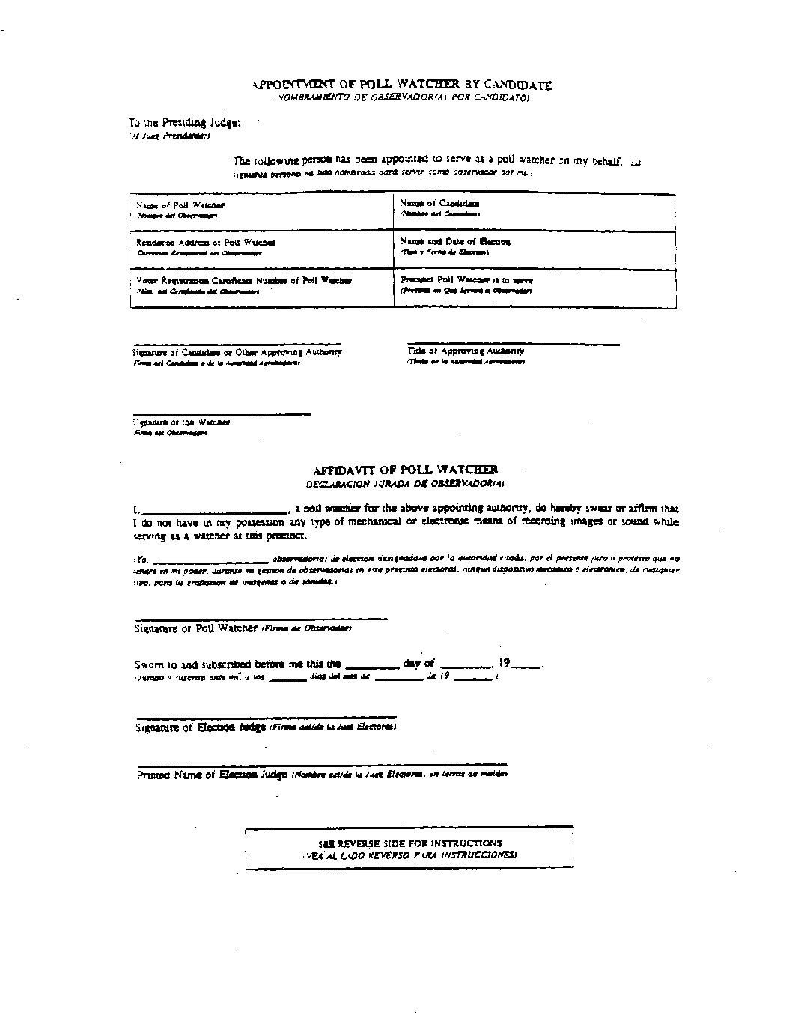
Poll Watchers by Candidate

Slide 30
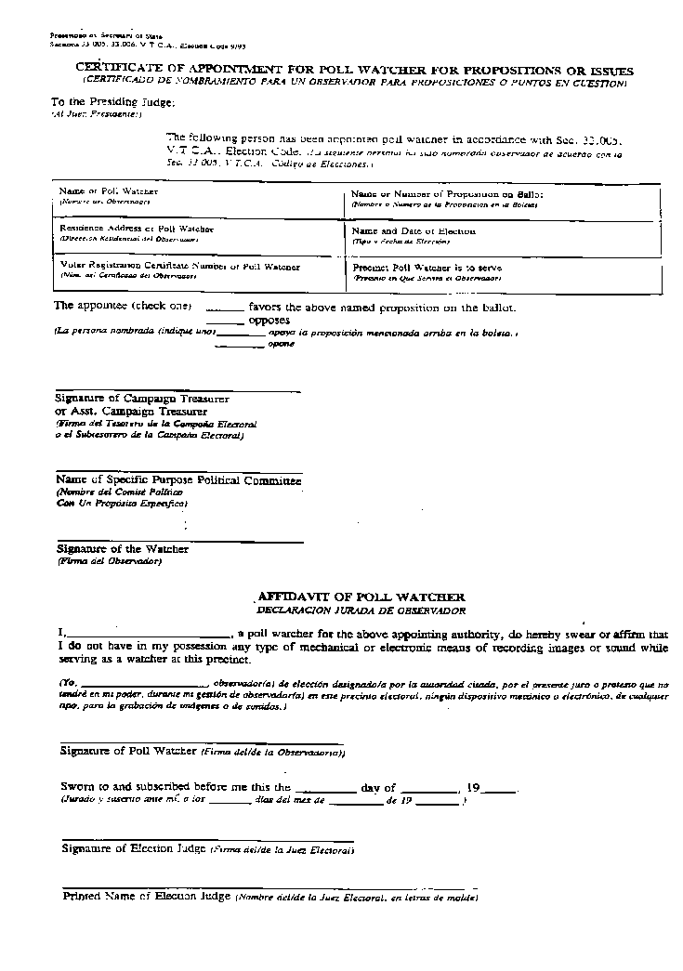
Poll Watcher by Propositions/Issues Pages 142-142a

Slide 31
Suspense Record Message Appears on Computer
Voter’s name appears on the Suspense List, indicating the voter’s card was returned by the Post Office. There is a possibility the voter has moved.
  Still reside in the same political subdivision.
  Voter must correctly complete and sign a Statement of Residence
  Attach completed Statement of Residence form to the white copy of combination form for Early Voting.
  Provide current ID
  If the Statement of Residence card is not filled out completely, the voter whose name is in Suspense will remain in Suspense.

Slide 32
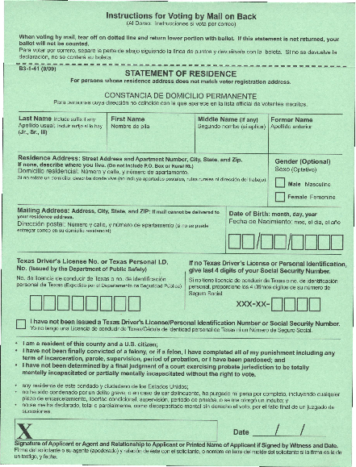
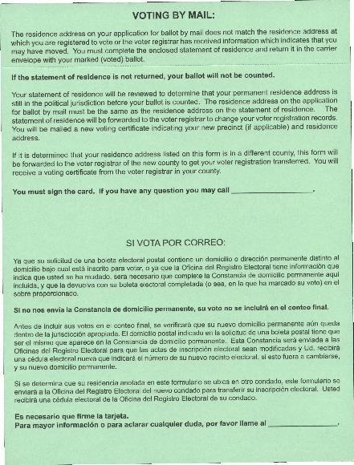
Statement of Residence
Please make sure to include voter’s VUID number somewhere on this form underneath the dotted line.

Slide 33
Provisional Voter
If the Registrar of Voters office is unable to verify the voter's registration, the voter may vote a Provisional Ballot.

Slide 34
Provisional Voting

Slide 35
Provisional Ballot Eligebility
Who can vote a Provisional Ballot?
Voter does not have one of the seven (7) Categories of Acceptable Forms of ID.
Voter has no voter registration certificate and is not on the list of registered voters under Section 63.009.
Voter’s name on ID documentation is not substantially similar to that on the list of registered voters.
An annotation next to the voter’s name indicates that the voter voted early, either by mail or in person.
Voting after 7:00 pm due to court order.
Voter on list, but residence address outside the political subdivision.
Other _________ please explain if above does not apply.

Slide 36
Provisional Voting Procedures
Unable to locate the voter’s file
Call voter registrar to verify registration
Voter registrar cannot verify the registration status of the voter
Voter votes a Provisional Ballot
Complete the Affidavit of Provisional Ballot Envelope
Presiding Election Officer checks reason voter is voting under the procedure for provisional voting and signs the Affidavit. Make sure you check the box stating if voter presented Acceptable Form of ID or not
Presiding Election Officer enters information into computer and prints a provisional label.
Presiding Election Officer issues the provisional ballot and Secrecy envelope.
Be sure to give clear instructions.

Slide 37
Affidavit for Provisional Voter
JUDGES RESPONSIBILITIES
Completes the Heading, Date, Location, Precinct Number, Judge’s name and the Provisional Ballot Access Code on the Affidavit of Provisional Voter.
Verifies that all information is filled out correctly and legible
Completes the second part of the form, checks reason, dates and signs the form
This Affidavit will also register the voter
Enters Affidavit information into Computer to generate a Provisional ID label
Enters the Provisional Voter’s name on the Early Voting List of Provisional Voters form
Informs voter that a Notice to Provisional Voter will be mailed, stating whether or not his/her ballot has been counted.
Give voter a copy of the Notice to Provisional Voters
VOTERS RESPONSIBILITIES
Voter will complete the first section of the Provisional Ballot Affidavit and sign form.
Places voted ballot into Ballot Secrecy envelope.
Places Ballot Secrecy Envelope inside Provisional Voter Affidavit
Places Provisional Voter Affidavit in Provisional Ballot Bag.

Slide 38
Affidavit for Provisional Voter
Top portion filled out by Judge
Completed by Voter
Place Provisional Ballot Access Code (PBAC) here
Completed by Judge
Make sure you check if voter had ID or not.
Completed by Voter Registrar
Ballot Board

Slide 39
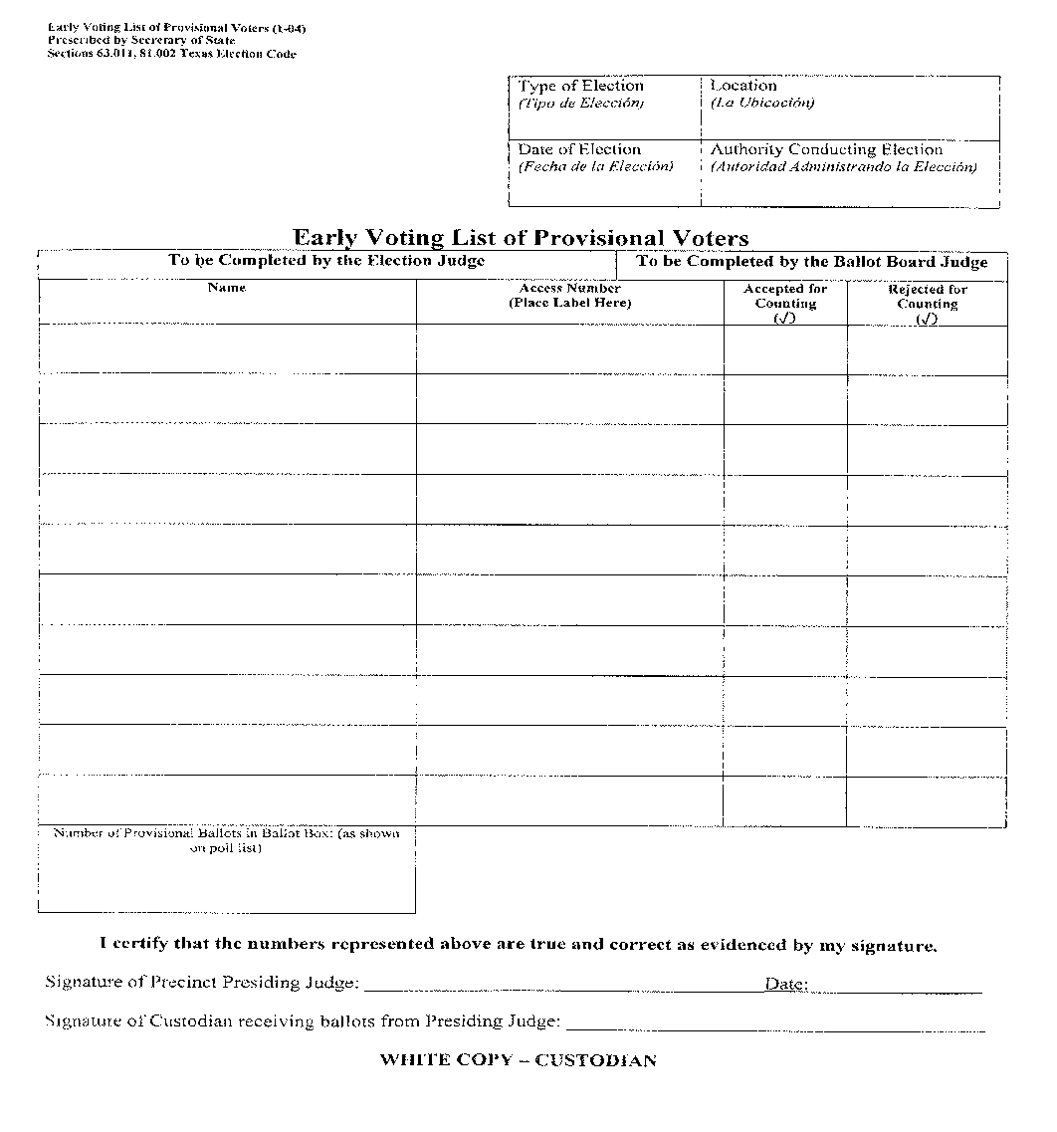
List of Provisional Voters

Slide 40
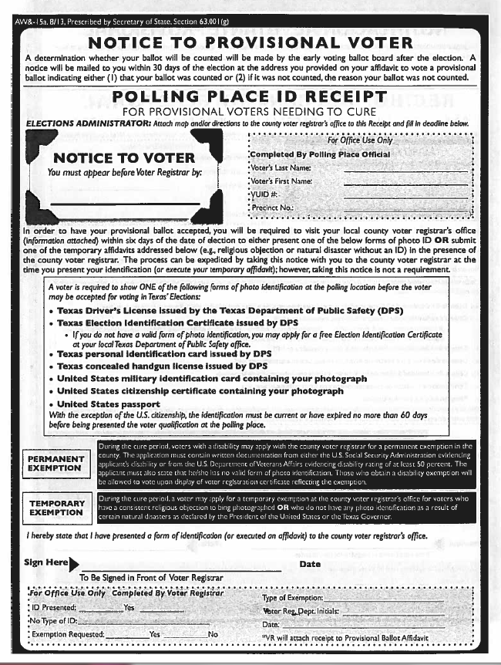
Notice to Provisional voter:
Voter will have 6 calendar days after the election day to visit our office to present one of the 7 ID or submit in order to have their provisional ballot counted.

Slide 41
Seven Steps Needed to Complete a Provisional Ballot
Affidavit for Provisional Voter
Label on Provsional Combination Forms
Voting List of Provisional Voters
Obtain correct precinct number and ballot style, and write precinct number on correct ballot. Make sure the box that is asking if Voter had an ID or not is checked.
For Ballot to be accepted, it must be placed into the Ballot Secrecy Envelope, place the Secrecy Envelope into the Affidavit for Provisional Voter Envelope. Ballots not placed in the Affidavit will not be counted.
Have voter place Affidavit for Provisional Voter into the Provisional Ballot Bag
Give Notice to Provisional Voter.

Slide 42
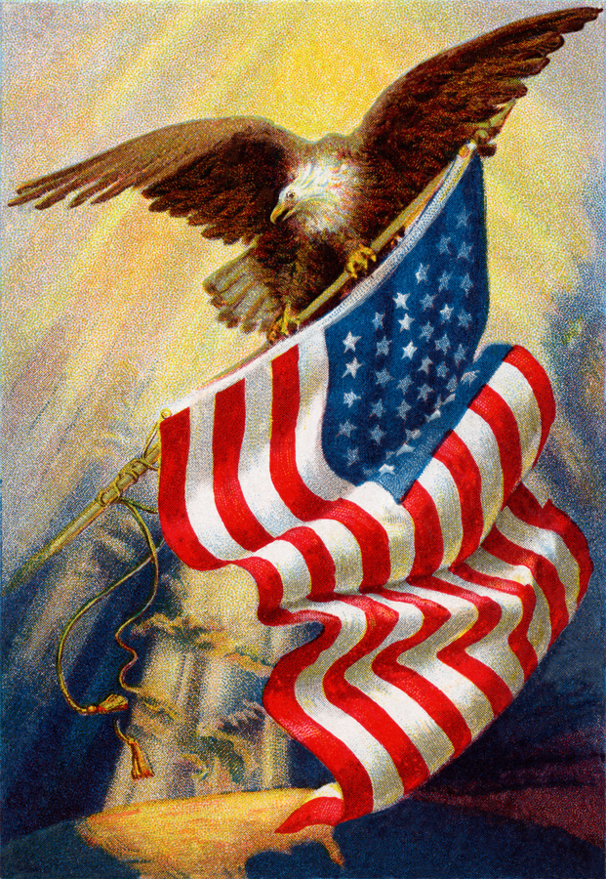
THANK YOU FOR YOUR SERVICE AS AN ELECTION OFFICIAL

